Slide 1

Group 9
Drowsy Driver Detection
Sameera Boppana, Inu Tenneti, Vedant Paithane, Ziyi Zhou, Darwin Ye

Slide 2
Problem Objective
Data Gathering
Content
Exploratory Data Analysis
Image Preprocessing
Models + Results

Slide 3
Group 9
YOLO
Efficient
Net
Problem Objective
CNN
Classification
CNN
Detection
Utilizing deep learning models to detect if a driver appears to be drowsy when driving
Notes:
Our objective is to unitilize DP models such as YOLO, Efficient NET, CNN Classification and Detection to detect if a driver appears to be drowsy when driving.

Slide 4
Data Gathering
Tiktok/Youtube videos
Generate frames from videos
Create Bounding Boxes using Roboflow
Model Training
Image Preprocessing
Obtain Bounding Box Coordinates
Notes:
We first took videos from tiktok and youtube, split them into frames. Then we manually drew bounding boxes around the eye sections on Roboflow. After that, we obtained bounding box coordinates to preprocess the image for model training.

Slide 5
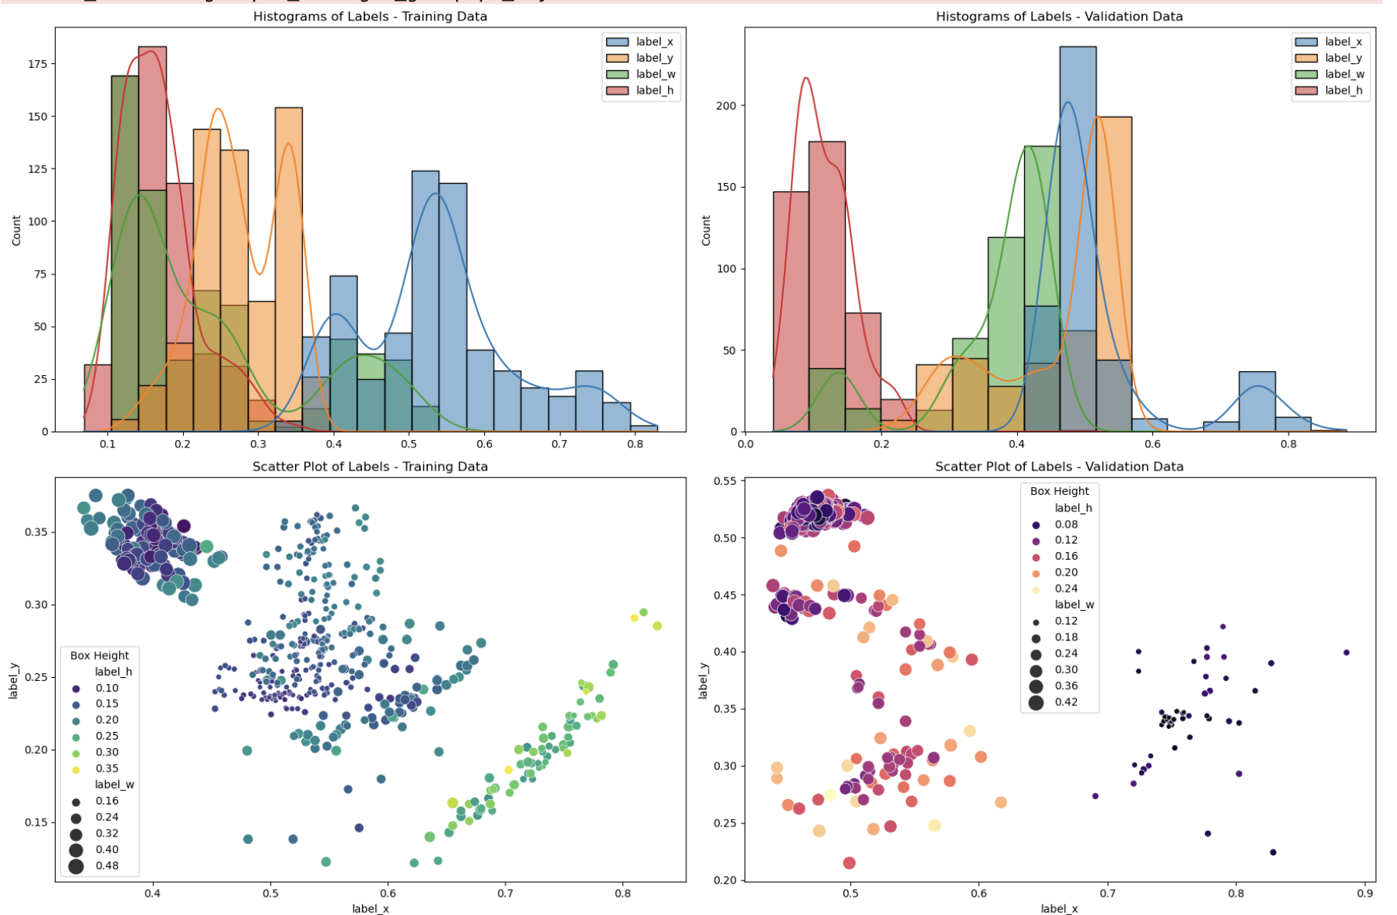
Exploratory Data Analysis
Dataset Overview:
Training Data: 590 images
Validation Data: 418 images
No Missing Values
Histogram Analysis:
Histogram shows distribution of bounding box position and size on images
The distribution of the image size varies but is slightly right skewed - most bounding boxes are smaller
Scatterplot Analysis:
Scatterplots show the relationship between x and y coordinates of the bounding boxes - colored by width and height
Notes:
Here is the EDA, since we generate our own data, there no missing value. The histogram shows the bounding box position and size on images, the sizes are slightly right-skewed. The scatterplot shows the x and y coordinate relationship.

Slide 6
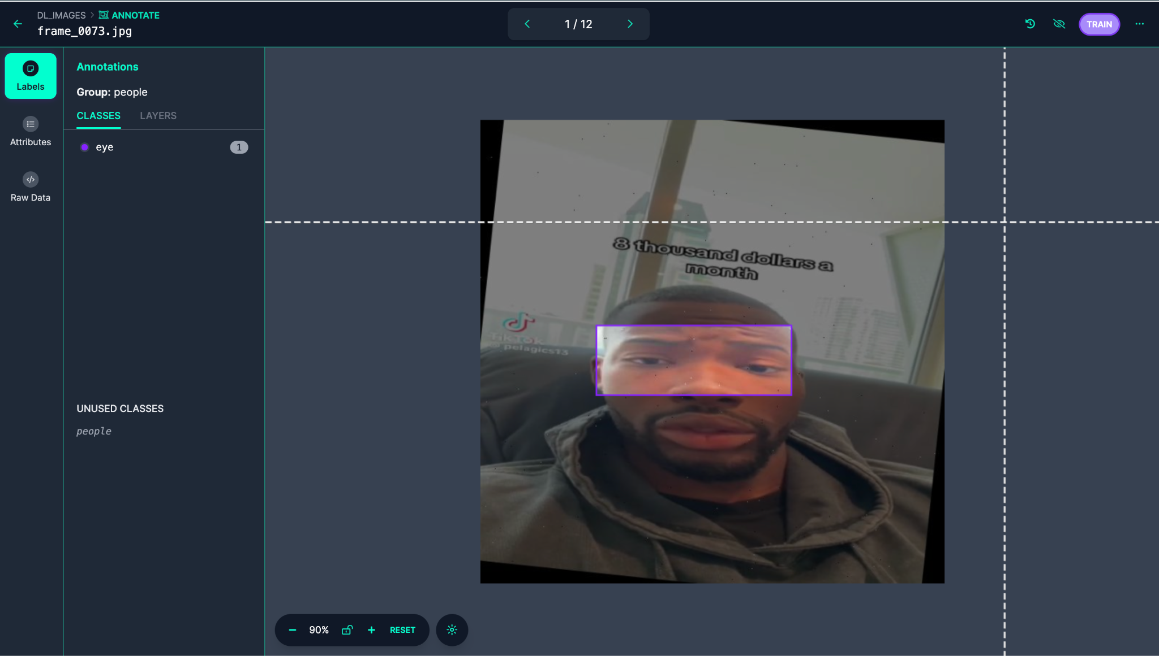
Image + Data Preprocessing
Object Classification:
Load and convert images to RGB
Resize images to 244x244 pixels
Convert class labels to integer format
Object Detection:
Images are resized to fit within a given input size while maintaining the original aspect ratio
A new image matrix is created to ensure that the image fits a standard size
Bounding boxes are recalculated to correspond to the resized image dimensions.
Using RoboFlow to Create Boundary Box Example:
Notes:
Object Classification
RGB Conversion: The process begins by converting images from OpenCV's default BGR format to RGB to ensure consistency in color representation across all images, which is crucial for the neural network's performance.
Cropping and Resizing: Images are cropped based on bounding box coordinates to focus on relevant parts and resized to a uniform size of 244x244 pixels. This standardization is essential because convolutional neural networks require fixed-size inputs.
Label Conversion: Class labels are converted from string to integer format, facilitating the classification process as machine learning models require numerical inputs to perform calculations.
Object Detection
Aspect Ratio Maintenance: During resizing, the original aspect ratio of the images is maintained to avoid distortion. This is important because distortions can adversely affect the model’s ability to accurately detect objects.
Standardized Image Matrix: A new image matrix of a standard size is created to accommodate the resized image, filling any extra space with zeros. This ensures that all images fed into the network are of uniform size, which simplifies processing and enhances model training efficiency.
Bounding Box Adjustment: Bounding boxes are recalculated to align with the resized images, ensuring they accurately define the locations of objects within the images at their new dimensions. Accurate bounding boxes are critical for training detection models to locate objects precisely.

Slide 7
IOU Metric
Intersection over Union (IoU) is a performance metric that measures the overlap between the predicted bounding box and the ground truth bounding box.
IOU = (Area of Overlap) / (Area of Union)
IOU Values range from 0 - 1:
0: There is no overlap between the predicted bounding box and the ground truth
1: Perfect overlap between the predicted bounding box and the ground truth

Slide 8
Object Detection - CNN
Model Architecture:
Input Layer: 244x244 pixel images
Convolutional Layers: 64 filters, 3x3 kernel size, ReLU activation
Output Layers: Fully connected layers output bounding box coordinates
Regularization:
Dropout Rate: Around 0.5 in specific layers to reduce overfitting
L2 Regularization: Applied to penalize large weights and control overfitting
Results:
Validation IoU: 0.7474900484085083
Test IOU: 0.09928718954324722

Slide 9
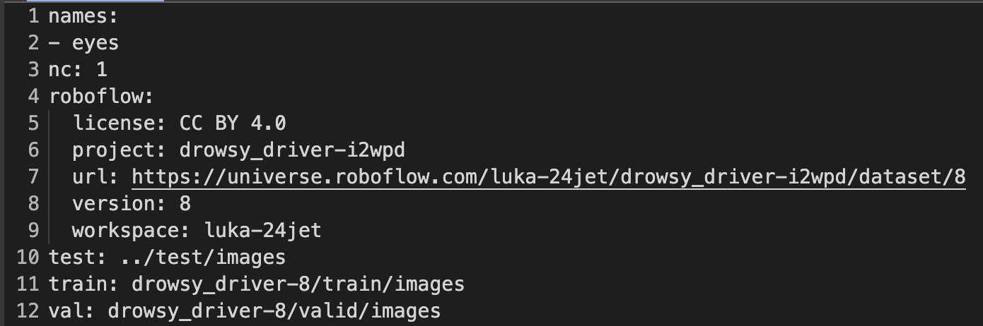
Object Detection - Pretrained YOLOv8
Back to Agenda Page

Slide 10
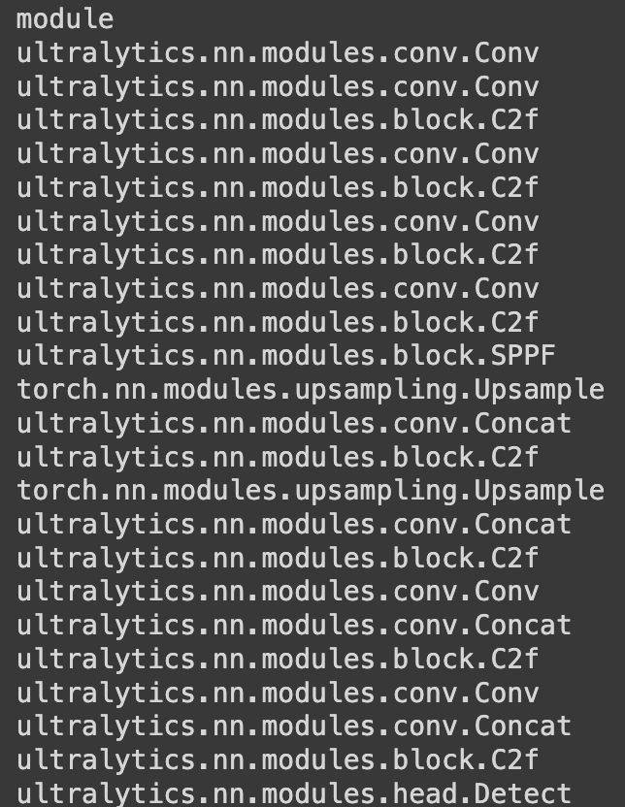
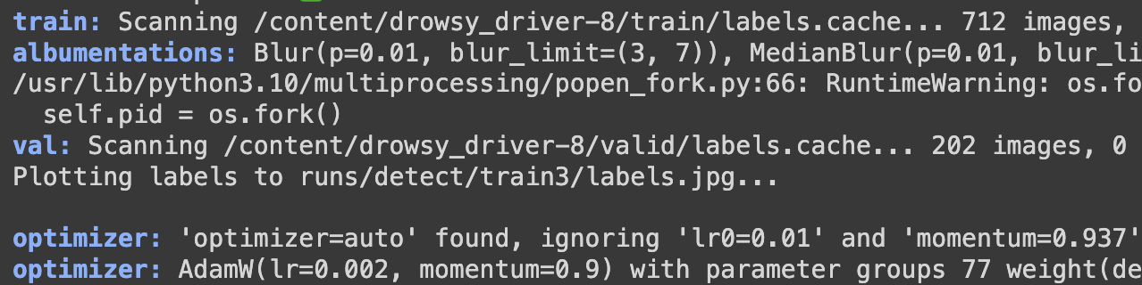
Object Detection - Pretrained YOLOv8
Architecture
Layers:
Convolution
C2f (self-defined, with Batch-Norm etc.)
Upsampling (increase resolution)
SPPF (Spatial Pyramid Pooling)
Concat (combine feature maps from layers)
Detect (object detection layer)
Back to Agenda Page

Slide 11
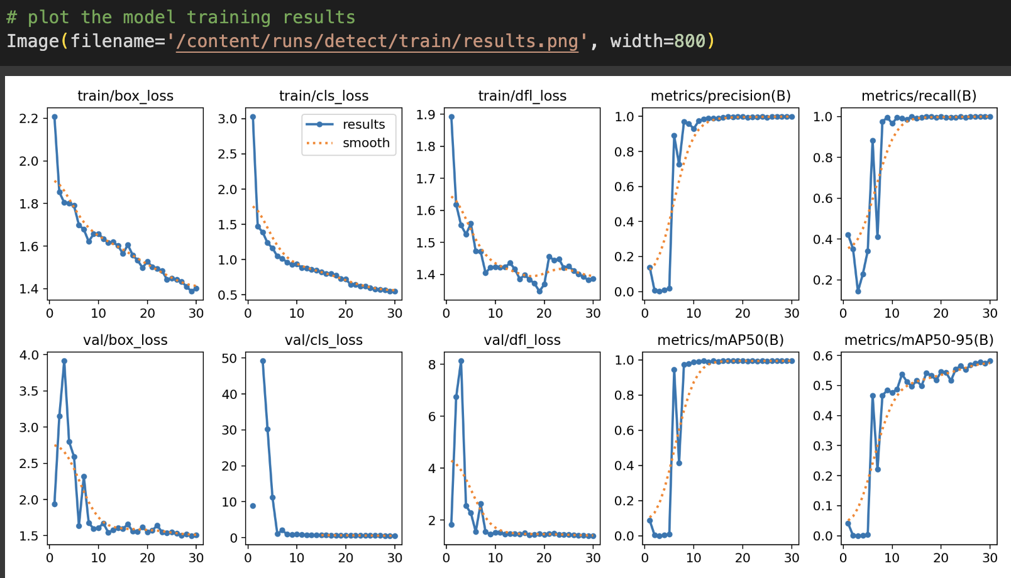
Object Detection - Pretrained YOLOV8
AP: Computes the area under the precision-recall curve
MAP50: Mean average precision when the IOU overlap is greater than 50%
MAP50-95: Averaging the AP values from threshold 0.5 to 0.95 by 0.05
Quick Demo!
Notes:
Recall for "Eyes Closed": True Positives / (True Positives + False Negatives) = 13 / (13 + 3) = 0.81. This metric tells us that the model successfully identified 81% of all actual "eyes closed" instances.

Slide 12
Object Classification - CNN
Model Architecture:
Convolutional Layers:
Three layers with filter sizes escalating from 32 to 256.
Each layer features kernel size options of 3 or 5, max pooling, and L2 regularization.
Dense and Dropout Layers:
One fully connected layer with 64 to 256 units, L2 regularization.
Dropout layer with rates from 0.2 to 0.5 to reduce overfitting.
Output Layer:
Single dense layer with sigmoid activation for binary classification.
Back to Agenda Page
Notes:
CNN on the full image not just cropped to the bounding box
three convolutional layers with increasing filter sizes (32 to 256) to capture complex image features.
Used max pooling and l2 regularization to prevent overfitting

Slide 13
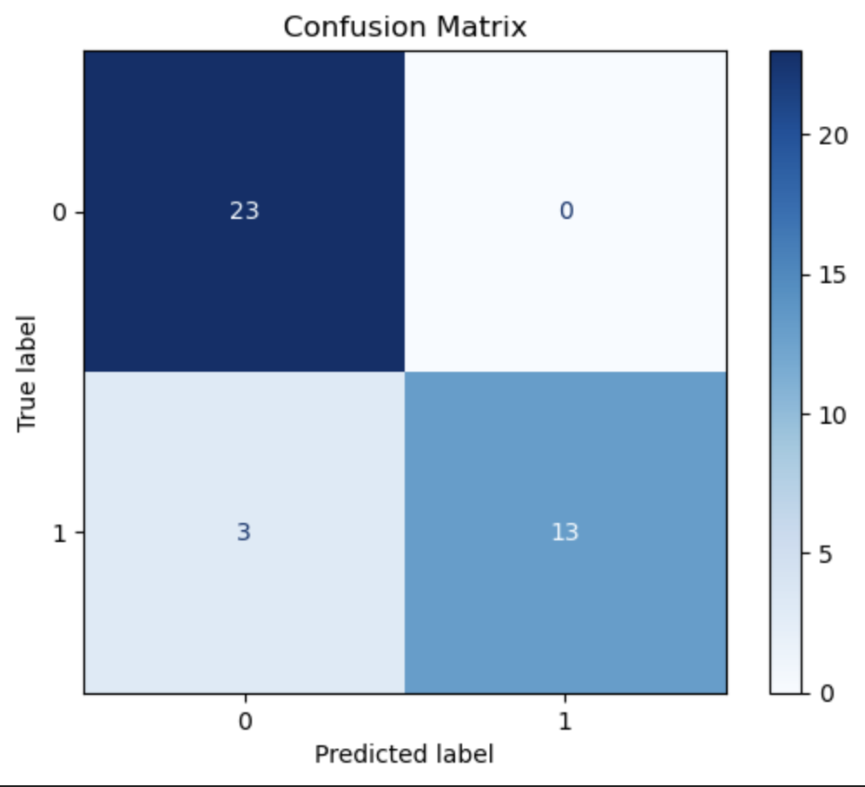
Object Classification - CNN
Results:
Validation Accuracy: 0.9659090638160706
Test Accuracy: 0.9230769276618958
0 = Eyes Open; 1 = Eyes Closed
Accuracy = 0.92
Precision for "Eyes Closed" = 1
Recall for "Eyes Closed" = 0.81
F1 Score for "Eyes Closed" = 0.9
Notes:
Recall for "Eyes Closed": True Positives / (True Positives + False Negatives) = 13 / (13 + 3) = 0.81. This metric tells us that the model successfully identified 81% of all actual "eyes closed" instances.

Slide 14
Object Classification - Efficient Net
Model Architecture:
EfficientNetB0:
Pre-trained on ImageNet: A large dataset with over 14 million labeled images.
Used as the base model without the top layers: Utilizes learned features from pre-training but customizes the final classification layers.
Custom Layers:
GlobalAveragePooling2D
Dense Layer (128 units): Fully connected layer with ReLU activation for feature extraction.
Output Layer (2 units): Fully connected layer with Softmax activation for binary classification.
Model Compilation:
Optimizer: Adam
Loss Function: Sparse Categorical Cross-entropy
Metrics: Accuracy

Slide 15
Object Classification - Efficient Net
Results:
Train Accuracy: 0.9974
Test Accuracy: 0.9487
Accuracy = 0.94
Precision for "Eyes Closed" = 0.89
Recall for "Eyes Closed" = 1.00
 | Predicted Eyes Open | Predicted Eyes Closed
True Eyes Open | 21 | 2
True Eyes Closed | 0 | 16
Back to Agenda Page

Slide 16
Thank you!

Slide 17
Appendix

Slide 18
Challenges
.
Class Naming Mismatch in Roboflow
Combine the pre-trained YOLO model and classification for cam streaming
.

Slide 19
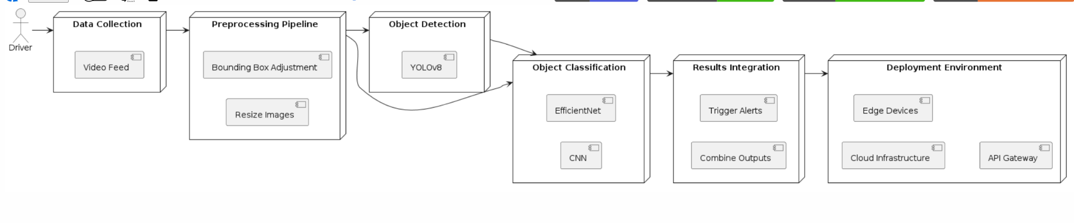
Model Operations - Deployment
.
.

Slide 20
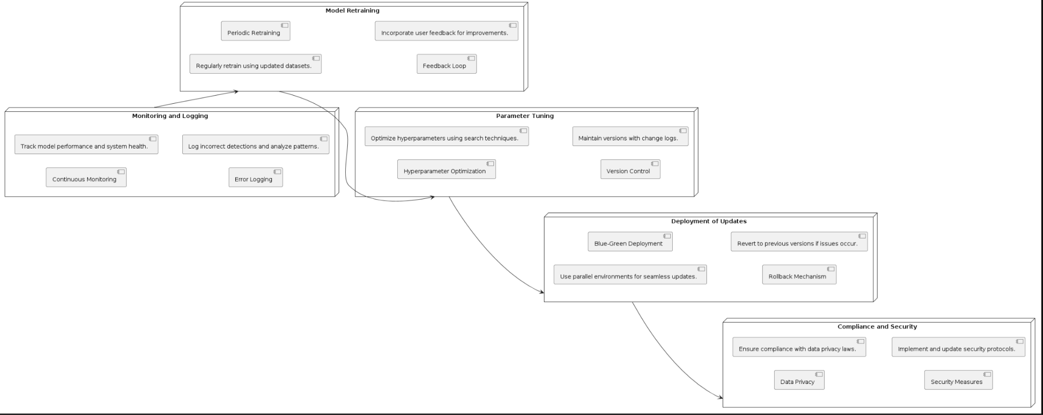
Model Operations - Maintenance
.
.

Slide 21
Interesting Resources.
Youtube series for creating transfer-learning model using YOLO:
https://www.youtube.com/watch?v=QtsI0TnwDZs
Building your own object detection model from scratch:
https://pub.towardsai.net/building-your-own-object-detector-from-scratch-with-tensorflow-bfeadfaddad8

